Slide 1
Good Afternoon

Slide 2
Linear Regression using Verilog
Project Guide : Sk.Irfan Ali & P.Shyam
Name :M. Syam Sundar
ID NO. :N150404

Slide 3
1)Multiplication and division using radix-4
2)Pipelined conventional and radix-4 CORDIC
3)Linear Regression using verilog
These things I have done in this semester

Slide 4
Linear Regression investigate the linear relationship between one or more independent varialbes and a dependent variable.

Slide 5
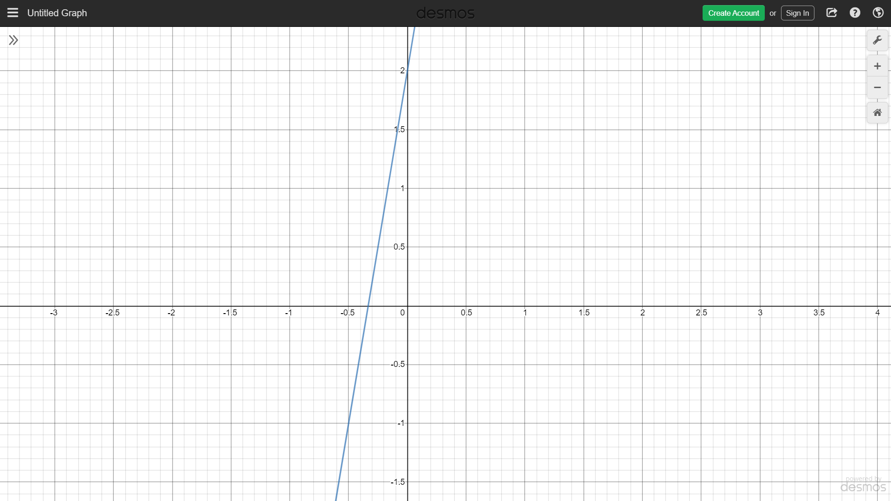
Suppose take a set of data points
X | Y
1 | 8
2 | 14
3 | 20
y=6x+2

Slide 6
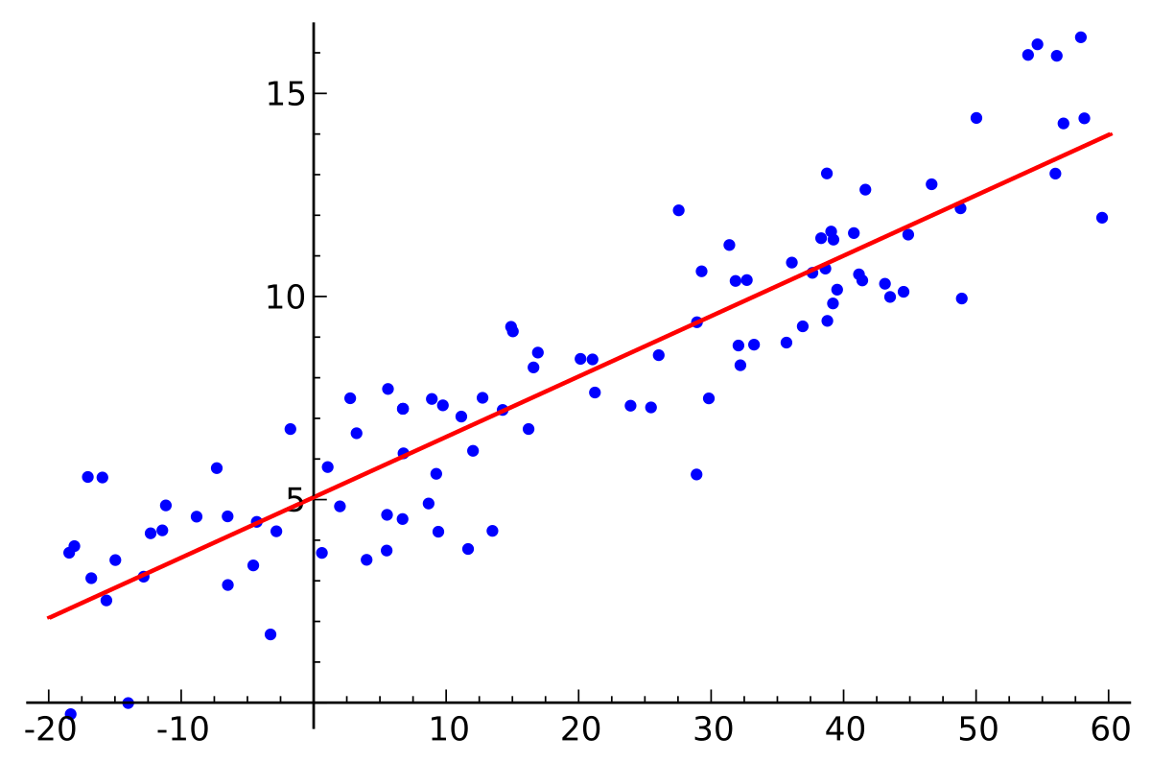
What about this type data .Can you find a line which fits for these data points.

Slide 7
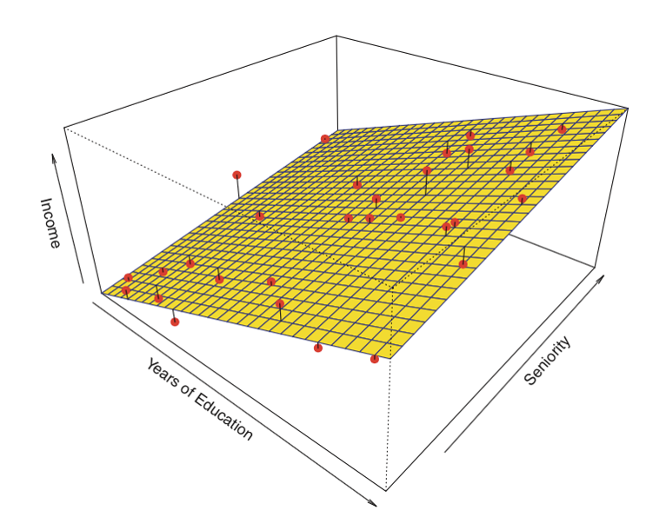

Slide 8
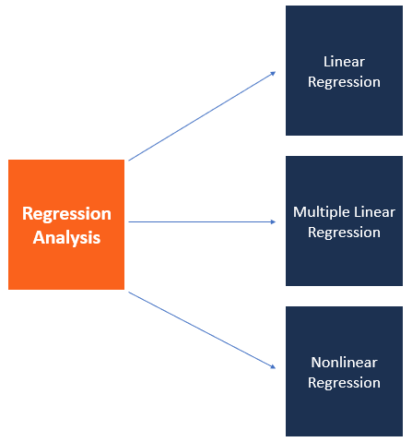

Slide 9
Applications of Linear Regression
* It tells whether a particular data set (say GDP, oil prices or stock prices) have increased or
decreased over the period of time.
*cigarette smoking is the independent variable of primary interest and the dependent variable
is lifespan measured in years, researchers might include education and income as additional
independent variables, to ensure that any observed effect of smoking on lifespan.

Slide 10
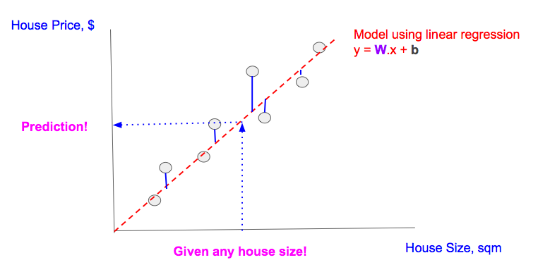

Slide 11
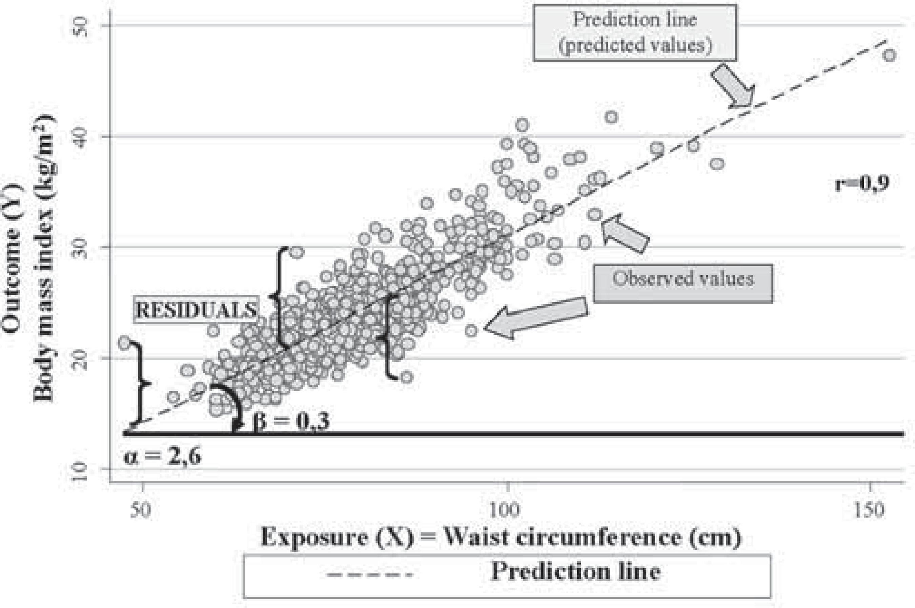

Slide 12
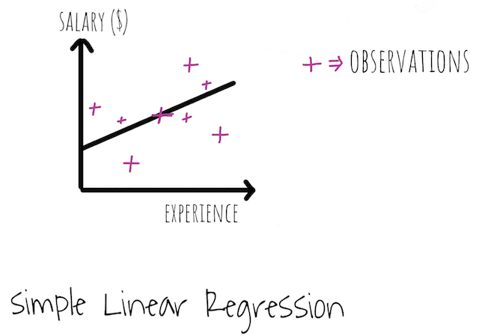

Slide 13
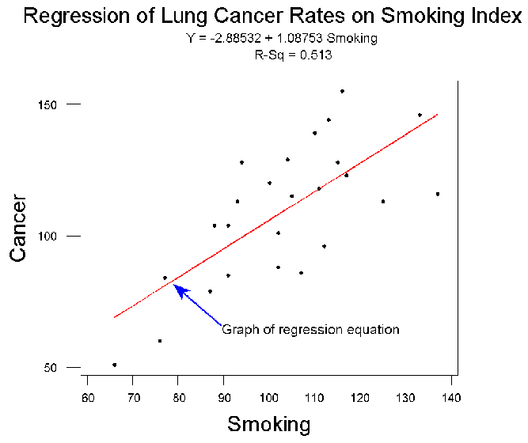

Slide 14
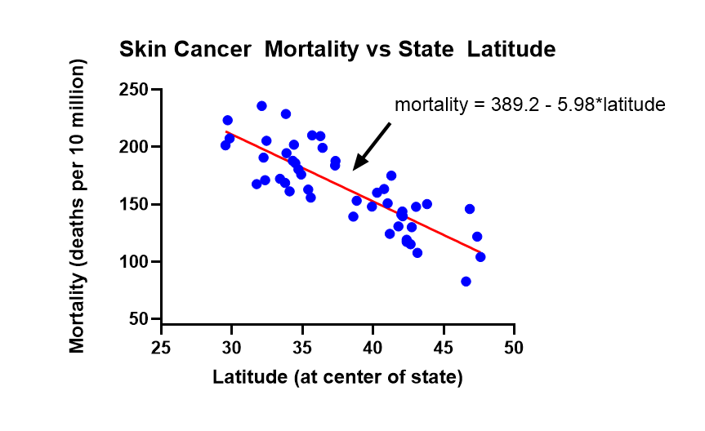

Slide 15
SUBTASKS TO IMPLEMENT THIS TASK

Slide 16
The subtasks we require is the stasitical properties of linear data
1)Mean
2)Standard Deviation
3)Standardization of Values
4)Correlation

Slide 17
Mean:
X | Y
1 | 8
2 | 14
3 | 20

Slide 18
Standard Deviation:
X | Y
1 | 8
2 | 14
3 | 20
SD_{x}=1
SD_{y}=6

Slide 19
Standardization of Values:
The mean of standardized values will always be zero, and the standard deviation will always be one.
The graph of standardized values will have exactly the same shape as the graph of raw data, but it may be a different size and have different coordinates.

Slide 20
Standardized Values:
X | Y
1 | 8
2 | 14
3 | 20
X_{i}* | Y_{i}*
-1 | -1
0 | 0
1 | 1

Slide 21
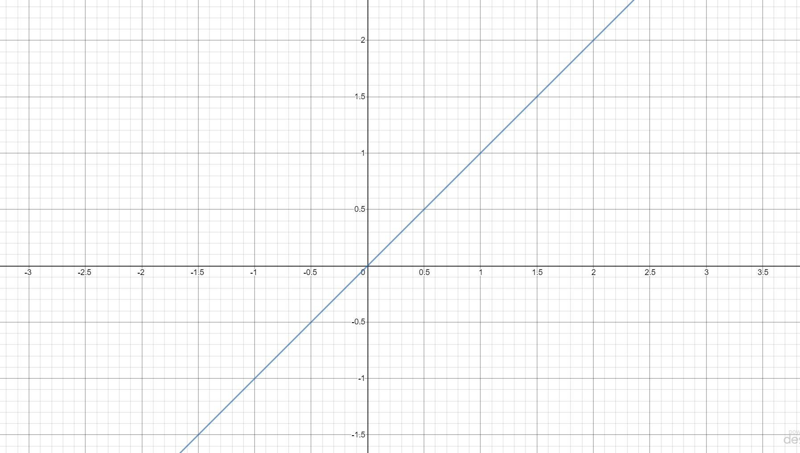
X_{i}* | Y_{i}*
-1 | -1
0 | 0
1 | 1

Slide 22
Correlation :
X_{i}* | Y_{i}*
-1 | -1
0 | 0
1 | 1
r=1

Slide 23
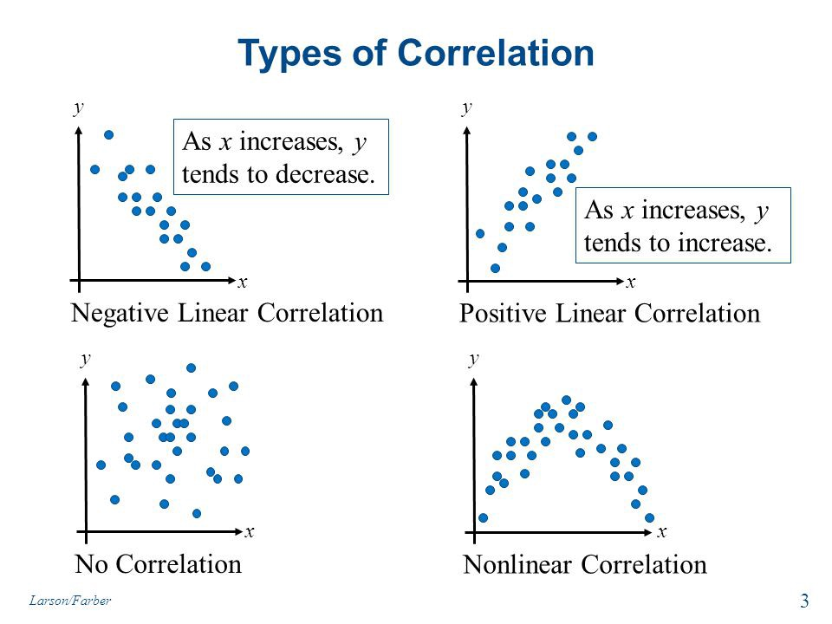

Slide 24
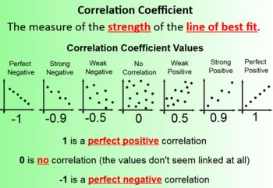

Slide 25
Finally, our line equation that best fits to our given data is
in terms of standardise values
in terms of unsatandardised values

Slide 26
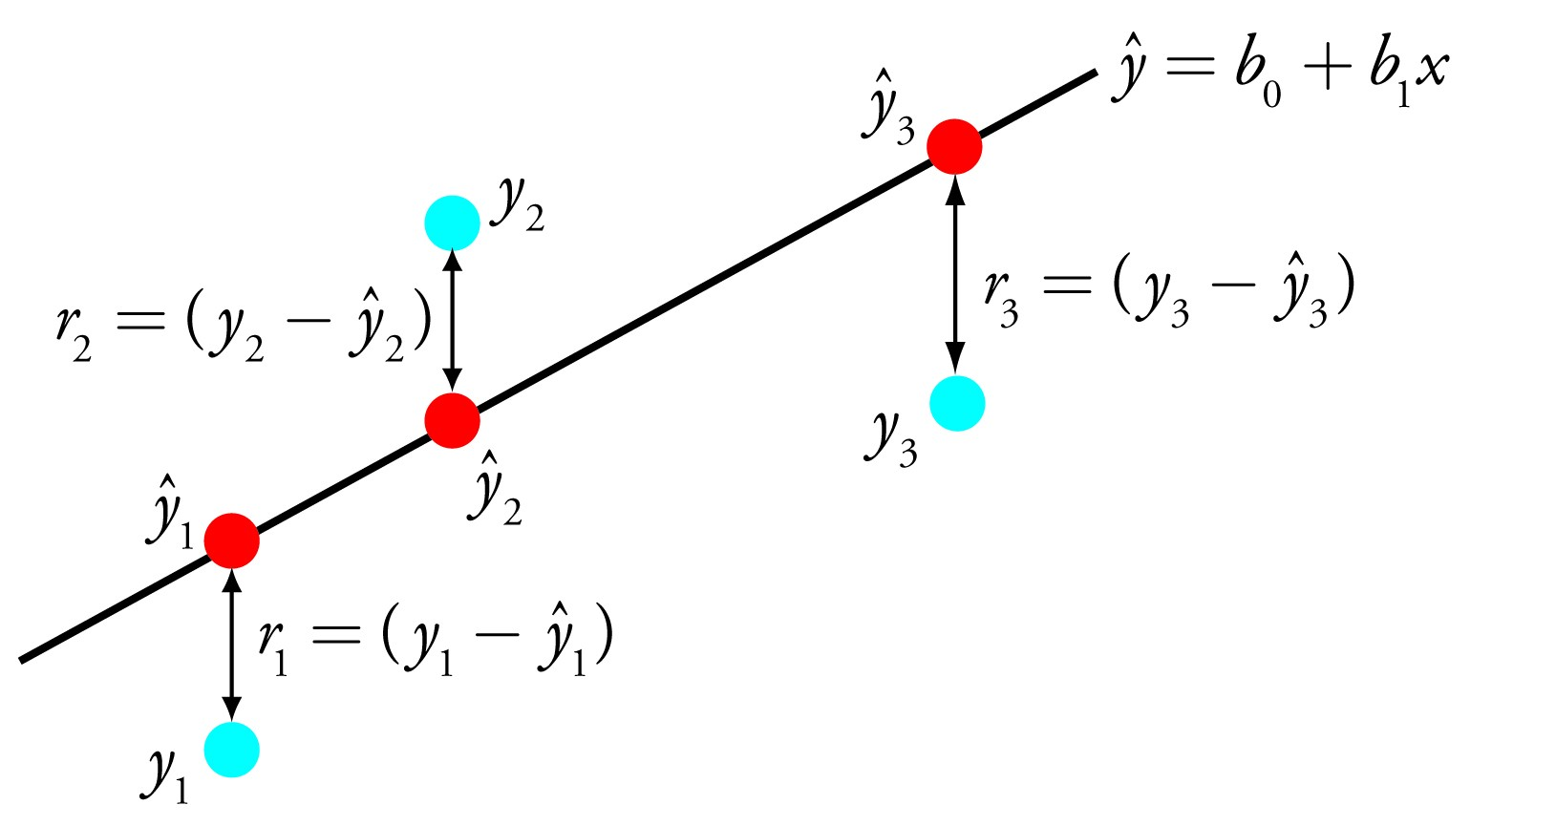
The above equation gives minimum Sum of Squared Error(SSE) than any other line .So this is the best fit line than any other

Slide 27
Simulation Results

Slide 28
module m_sd_r(clk,a0,a1,a2,b0,b1,b2,in,Mx,SDx,My,SDy,r,out); input clk; input [63:0] a0,a1,a2,b0,b1,b2,in;//now give input greater than mean x i.e in>Mx output [63:0]Mx,SDx,My,SDy,r,out; parameter n=3,k=8;//n=no.of data points wire [63:0]x[n-1:0]; wire [63:0]y[n-1:0]; assign x[0]=a0, x[1]=a1, x[2]=a2, y[0]=b0, y[1]=b1, y[2]=b2; wire [63:0] mx[n:0]; wire [63:0] my[n:0]; wire [63:0] sX[n-1:0]; wire [63:0] sY[n-1:0]; wire [63:0] sx[n-1:0]; wire [63:0] sy[n-1:0]; wire [63:0] Sx[n:0]; wire [63:0] Sy[n:0]; wire [63:0] sdx; wire [63:0] sdy; genvar i; generate begin assign mx[0]=0,my[0]=0; for(i=0;i<n;i=i+1) begin:tom assign mx[i+1]=x[i]+mx[i]; assign my[i+1]=y[i]+my[i]; end division u1(clk,64'h3000000,mx[n],Mx);///n division u2(clk,64'h3000000,my[n],My);///n assign Sx[0]=0,Sy[0]=0; for(i=0;i<n;i=i+1) begin:jerry assign sX[i]=(x[i]>Mx)?(x[i]-Mx):(-x[i]+Mx); multiplication u3(clk,sX[i],sX[i],sx[i]); assign Sx[i+1]=Sx[i]+sx[i]; assign sY[i]=(y[i]>My)?(y[i]-My):(-y[i]+My); multiplication U3(clk,sY[i],sY[i],sy[i]); assign Sy[i+1]=Sy[i]+sy[i]; end division u4(clk,64'h2000000,Sx[n],sdx);///n-1 division U4(clk,64'h2000000,Sy[n],sdy);///n-1 //square root wire [63:0] px [k:-1]; wire [63:0] py [k:-1]; wire [63:0]ox [k:0]; wire [63:0]oy [k:0]; assign px[-1]=64'h1000000; assign py[-1]=64'h1000000; for(i=0;i<=k;i=i+1) begin:xyz division u5(clk,px[i-1],sdx,ox[i]); division U5(clk,py[i-1],sdy,oy[i]); assign px[i]=(px[i-1]+ox[i])>>1; assign py[i]=(py[i-1]+oy[i])>>1; end assign SDx=px[k]; assign SDy=py[k]; // wire [63:0] X[n-1:0]; wire [63:0] Y[n-1:0]; wire [63:0] p[n-1:0]; wire [63:0] S[n:0]; assign S[0]=0; for(i=0;i<n;i=i+1) begin:standard_values///sign problem division u6(clk,SDx,x[i]-Mx,X[i]); division U6(clk,SDy,y[i]-My,Y[i]); multiplication u7(clk,X[i],Y[i],p[i]); assign S[i+1]=S[i]+p[i]; end division u8(clk,64'h2000000,S[n],r);//n-1 SIGN problem end endgenerate wire [63:0] m,m_num,mX; multiplication u9(clk,SDy,r,m_num); division u10(clk,SDx,m_num,m); multiplication u11(clk,m,(in-Mx),mX); assign out=My+mX; endmodule

Slide 29
module testbench_of_LR( );
reg clk;
reg [63:0] a0,a1,a2,b0,b1,b2,in;
wire [63:0]Mx,My,SDx,SDy,r,out;
m_sd_r m1(clk,a0,a1,a2,b0,b1,b2,in,Mx,SDx,My,SDy,r,out);
initial
begin
clk=0;
forever #10 clk=~clk;
end
initial
begin
a0=63'h1000000;
a1=63'h2000000;
a2=63'h3000000;
///a3 to a9
b0=63'h7800000;
b1=63'he800000;
b2=63'h13800000;
///b3 to b9
in=63'ha000000;
end
endmodule

Slide 30
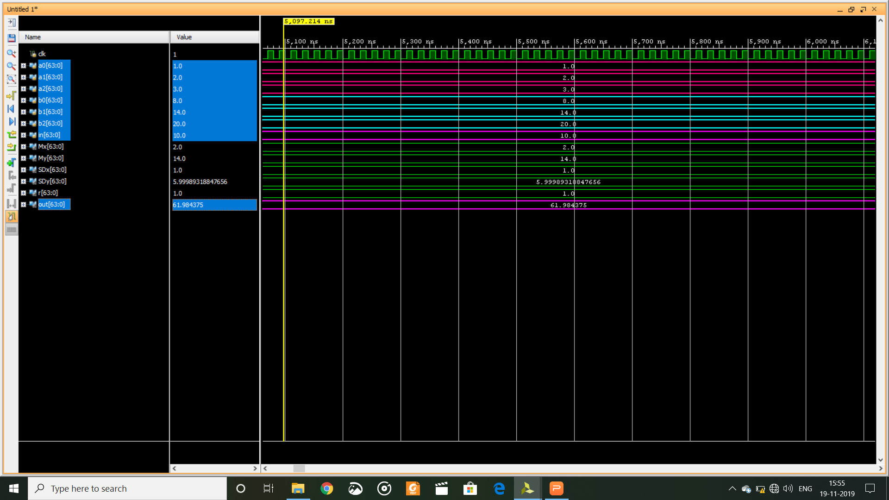

Slide 31
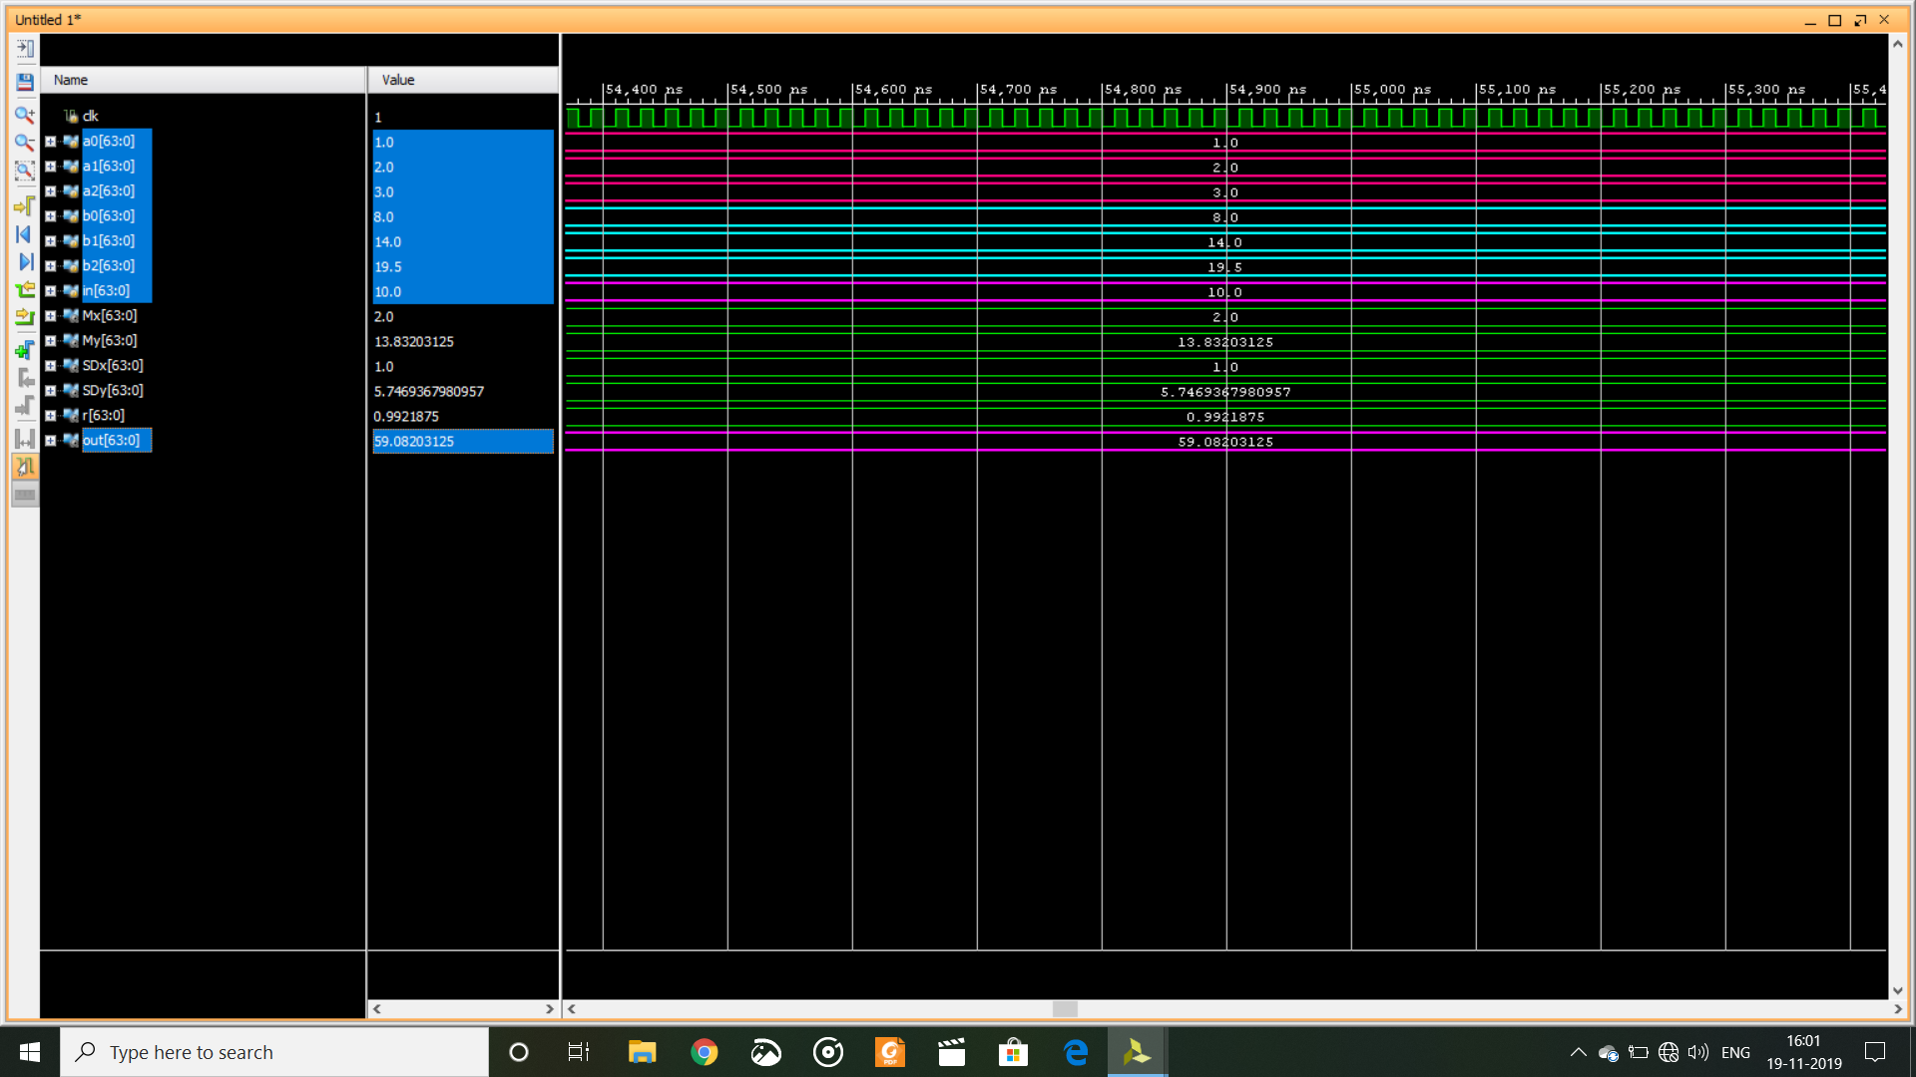

Slide 32


Slide 33
GPU vs FPGA

Slide 34
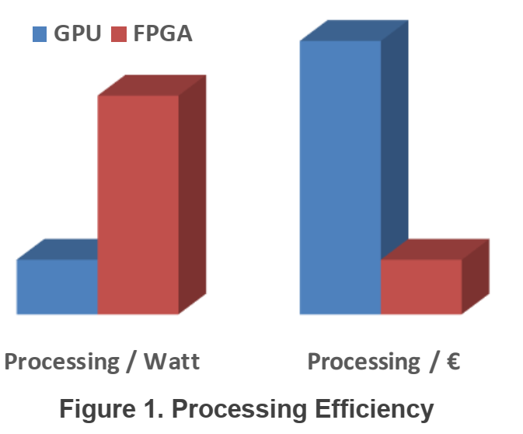

Slide 35
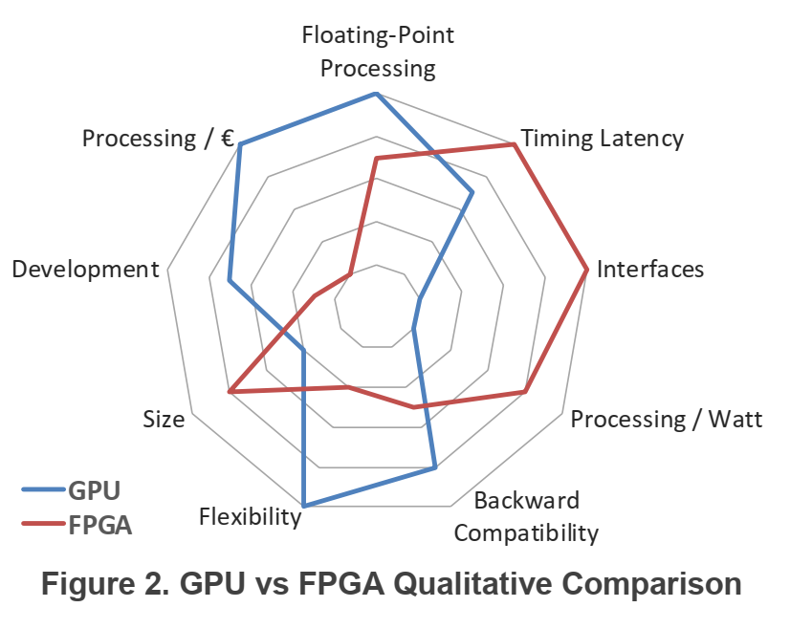

Slide 36
Any Queries

